Slide 1

The Business of Law: The Profitable Practice
Christopher Simon
www.GeorgiaClaims.com

Slide 2
Why Should you Listen?
Personal Injury Cases Only
Opened in May 2009, Grossing 7 Figures by 2011.
Three lawyers, two support staff
Average $5,000,000 a year in verdicts and settlements.
Swim in middle size cases.
Efficiency and expense monitoring.
Overhead never exceeds 35%
Referrals and Internet Cases

Slide 3
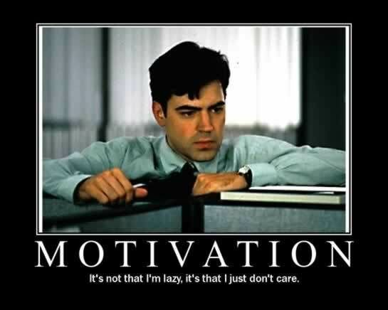
Practice with Profit
Focus on Income Producing Activities
What Can be Systemized
What Can be Outsourced or Eliminated?
What is Your Market Advantage?
What Isn’t being Measured?

Slide 4

The Unexamined Practice is Not Worth Building
Jamie Dimon of JP Morgan Just Eliminated Voice Mail
If they can change on a dime, so can you.

Slide 5
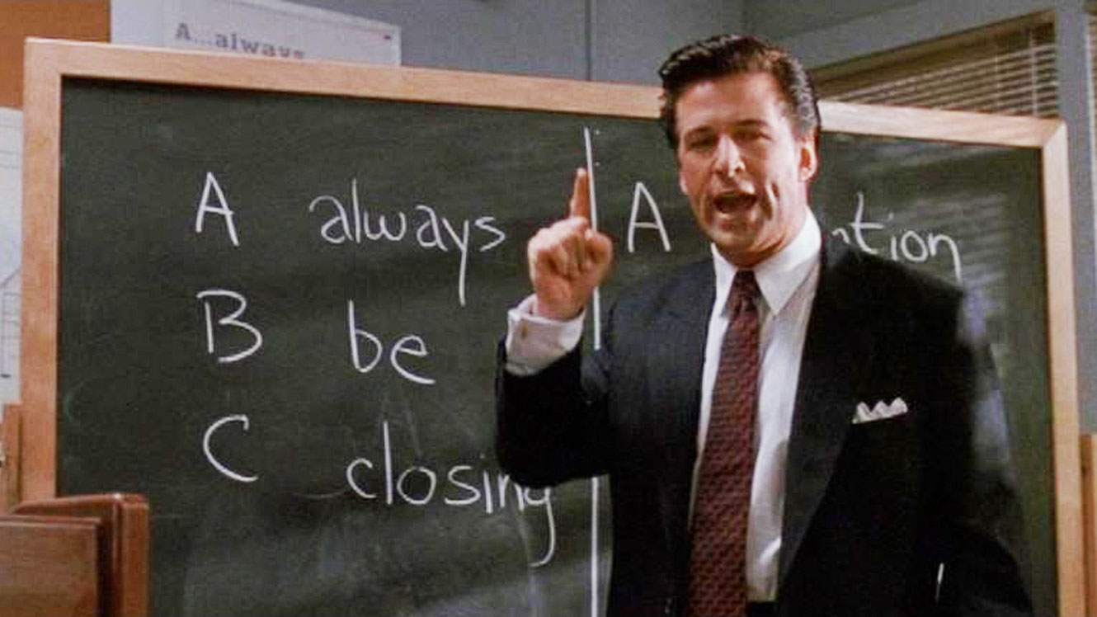
The Unexamined Practice is Not Worth Building
Do you know your best 5 cases off the top of your head?
Do you know which 5 of your cases will give you the highest income per hour invested?
What gets measured, gets managed
Productivity is doing the most amount of work in the least amount of time.
Always be closing, case aging reports

Slide 6
Productivity Creates a Profit
Busyness does not
Take out a Sheet of Paper
Write down everything you do in a typical day
Note every call; what was discussed and for how long.
Every email, even personal ones.
Every single task.
At the end of the day, break it down.
Commit to doing this tomorrow.

Slide 7
Income Generation v. Daily Grind
Make a Simple Table
Outsource | Income Generating | Personal Time Sucks
Staff meeting | Case roundtable | Fantasy Football
Setting a deposition date | Taking a deposition
Going through discovery responses with client 1st time | Hitting the priors, current, medical providers and wages before submitting the responses
Putting medicals in chrono order | Reading the medicals and building a table to see the big picture
Designing and building website | Writing web page articles

Slide 8
Productivity Creates a Profit
Busyness does not
Do not play “Misery Poker”
Late night responses to Motions for Summary Judgment on cases you knew not to take.
Realizing at deposition that the property damage photos are weak.
Realizing during trial prep that you have priors or sizeable gaps in treatment

Slide 9
Who Answers the Phone?
Most Common Complaint is No Call Back and No Human Answers the Phone
“In fact, customer satisfaction studies continue to report that each dissatisfied client will tell between ten and twenty people about their bad experience. That’s ten to twenty potential new clients that you’ll never see. But keep your clients happy and you’ll reap the benefits of the same word-of-mouth network that could have quickly tanked your reputation.”
Excerpt From: Michael E. Gerber, Robert Armstrong, J.D. & Sanford Fisch, J.D. “The E-Myth Attorney.” Wiley, 2010-04-16. iBooks.
This material may be protected by copyright.

Slide 10
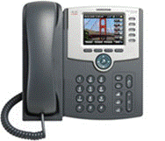
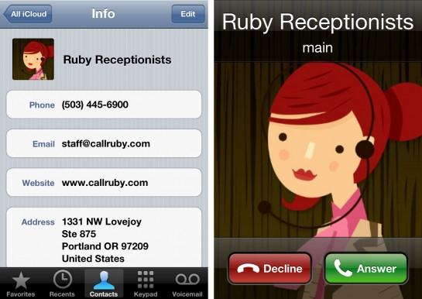
Intake System
First Line of Contact
Virtual Receptionist?
Dedicated local receptionist?
Teach to screen. Call Flow?
Cost? Efficiency?
Economy of Scale Applies
Direct to the Lawyer?
Voicemail?
Phonetag or Google Voice?

Slide 11
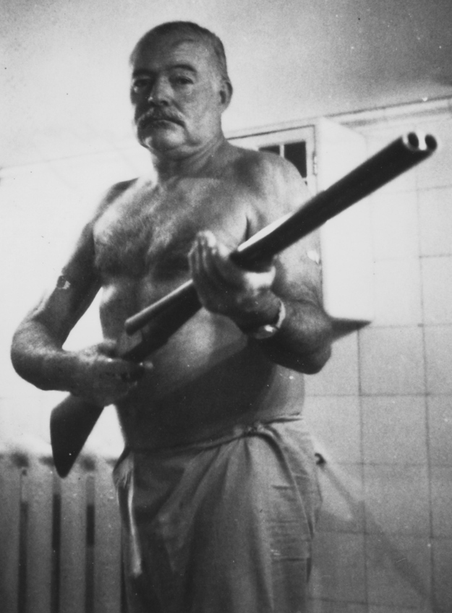
Have Lawyer Screen the Case Asap
Delay in strength and weakness recognition
Lose whales
Keep dogs
Avoid the sunken cost mistake.
Fire or refer out the dogs
PROTECT YOUR TIME!

Slide 12
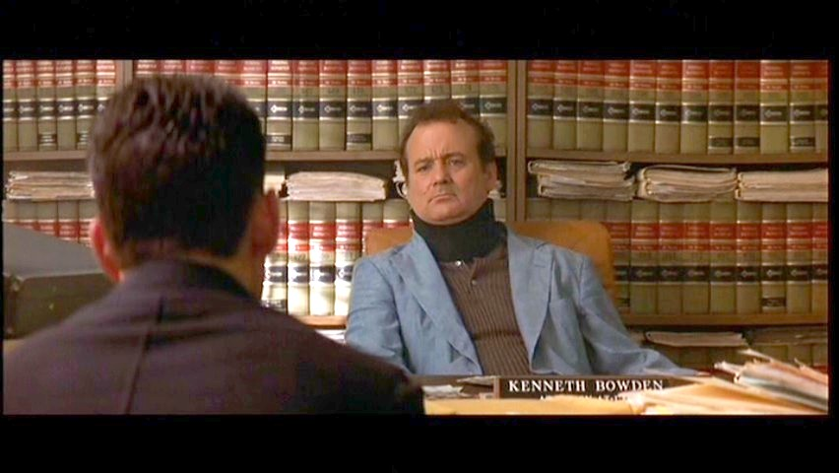
Lawyers Talk to the Client At Least Once for 10 Minutes in First 2 weeks
Either overdo the initial meeting. 2 Hours
Handle follow up calls in the first month.
Establish confidence in the client.
Reduces Poaching and Complaining

Slide 13




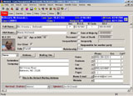

Case Management
Case value
Sources
Activity assignment and tracking
Document generation
Easy detailed reporting
Cloud based, phone accessible

Slide 14
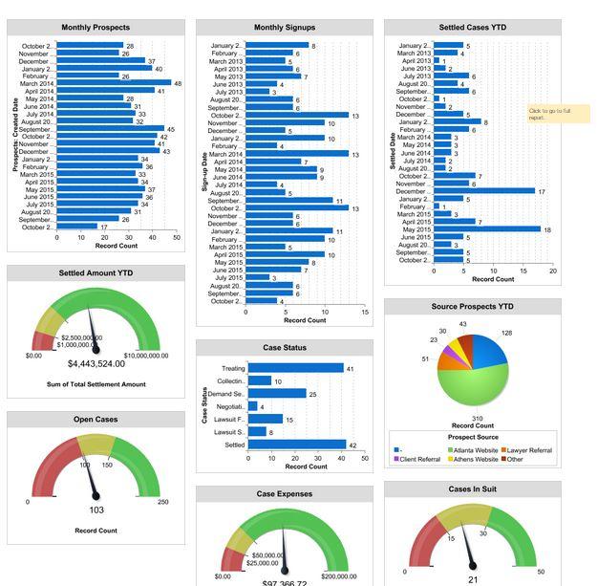

Slide 15
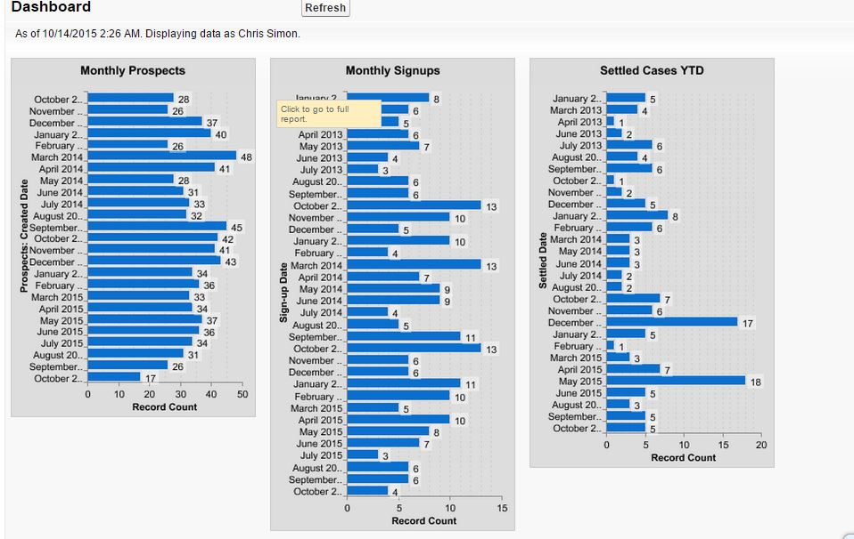

Slide 16
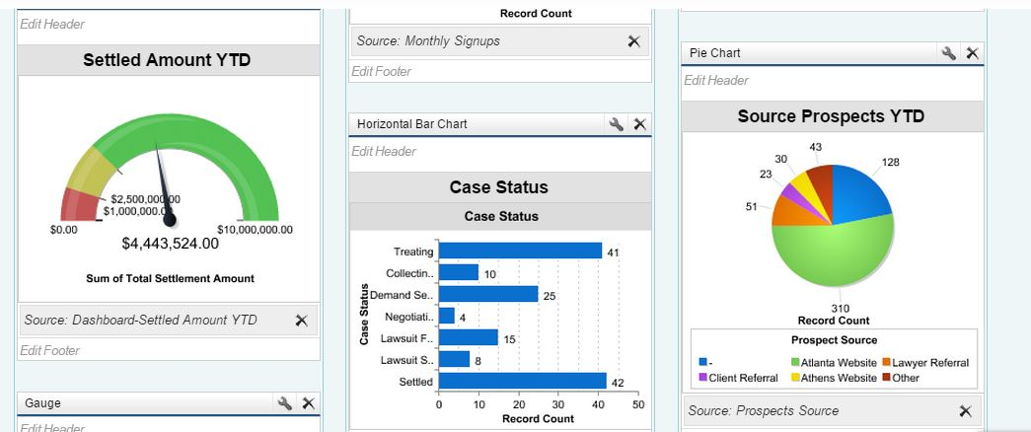

Slide 17
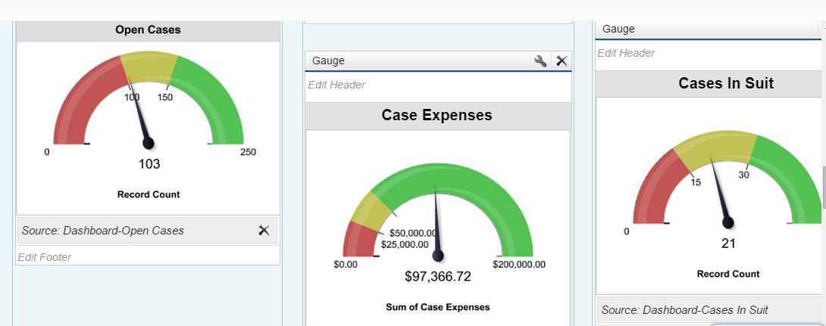

Slide 18


Email
State of Colorado
Richland School District 2
South Carolina Realtors Association
Aiken Technical College

Slide 19

Email
http://setup.googleapps.com/Home/small-business

Slide 20

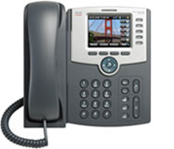
Phone Systems
$40 a month
Infinitely expandable
No hardware other than phone
Phone costs $200
Need a fast internet connection
Go to www.speedtest.net

Slide 21


Professional Image
Photographs and Google Local Listing
https://www.google.com/maps/about/partners/businessview/get-started/
360 Photo Inc. | Columbia | info@360photoinc.com | (239) 330-1373
Eric Blake | Columbia | Info@ColumbiaPics.com | (803) 574-9705

Slide 22




Websites
What is your Goal?
Market Size?
What is your budget?
What is your skill level?
Elbow Grease?

Slide 23



Apps and Tools

Slide 24

Execute Like a Boss
“On one level, wisdom is nothing more than the ability to take your own advice.”
Sam Harris
Do one thing I talked about today and if you see results, do the rest of it.

